Slide 1

Object Oriented Programming
OOP

Slide 2
Object-oriented programming
Referred to as OOP is another popular paradigm as it is applicable to certain types of problem with lots of reusable components which have similar characteristics.
OOP is built on entities called objects formed from classes which have certain attributes and methods.
OOP focuses on making programs that are reusable and easy to update and maintain.

Slide 3
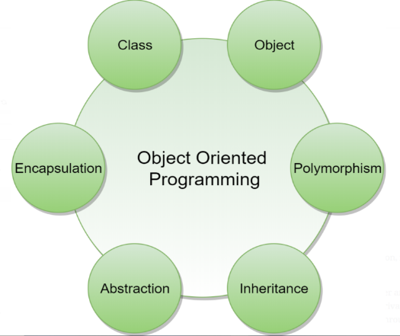
Features of OOP
OOP is programming paradigm that organizes code around objects and their interactions. The key features of OOP include:
Class
Object
Encapsulation
Polymorphism
Abstraction
Inheritance

Slide 4
Classes
A class is like a blueprint or a template that describes how to create objects.
It defines the structure and behavior that objects of that class will have.
A class represents a real life concept such as a person, an animal, a car, a house or a football.
Example, let's say you have a class called "Car". The Car class would define what a car should have, such as properties like color, make, model, and year, and methods like start, accelerate, and brake.
Class Car:
def _ _init_ _ (self, color, make, model):
self.color = color
self.make = make
self.model = model
def start_engine(self)
print(“Engine started.”)
def stop_engine(self)
print(“Engine stopped.”)
Creating two car Objects
Car1 = Car(“Red, “Toyota”, “Camry”)
Car2 = Car(“Blue” , “Ford”, “Mustang”)
Each car object is an instance of the car class

Slide 5
Classes
Once you have defined the Car class, you can create individual car objects, also known as instances, based on that class.
Each car object will have its own unique data for the properties (e.g., a red Ford Mustang from 2020) and can perform the actions defined by the methods (e.g., starting the engine, accelerating, and braking).
An instance of the Class “’car would be an object’.
Creating two instances of the Class car
car1 = Car("Red", "Toyota", "Camry")
car2 = Car("Blue", "Ford", "Mustang")

Slide 6
Object
An object in Object-Oriented Programming (OOP) is like a thing or an item that represents something specific. It could be an object from the real world, like a car or a person, or it could represent something more abstract, like an idea or a concept.
Example, if you have a class called "Car," an object of that class could be a specific car with its own unique.
Class Car:
def _ _init_ _ (elf, color, make, model):
self.color = color
self.make = make
self.model = model
def start_engine(self)
print(“Engine started.”)
def stop_engine(self)
print(“Engine stopped.”)
Creating two car Objects
Car1 = Car(“Red, “Toyota”, “Camry”)
Car2 = Car(“Blue” , “Ford”, “Mustang”)
Each car object is an instance of the car class
Example: car1 and car2 are two different objects created from the "Car" class. They each have their own set of attributes (color, make, model) and can perform actions like starting and stopping the engine independently

Slide 7
Think of an object as a container that holds two important things
Data
Behavior
An object has some data associated with it, which represents its characteristics or properties. For example, if we have an object representing a car, the data (attributes) associated with it and could include the car's color, make, model, and year.
An object also has some behavior or actions it can perform. These behaviors are defined as methods in OOP.
Example a car object might have methods like "start," "accelerate," and "brake" to represent the actions that a car can perform.

Slide 8
Think of an object as a container that holds two important things:
Properties/Attributes:
Methods
Properties, also known as attributes or fields, are the characteristics or data associated with an object. They represent the state or the data that an object holds. For example, a car object may have properties such as color, make, model, and year.
Methods are the functions or behaviors associated with an object.
They define the operations that an object can perform.
For example, a car object may have methods such as start(), accelerate(), and brake().

Slide 9
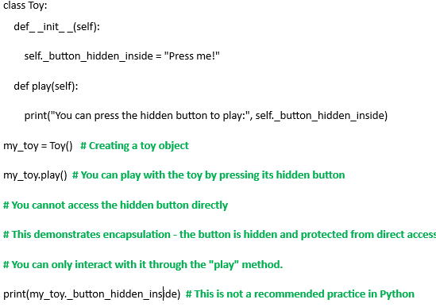
Encapsulation
In the example below, the _button_hidden_inside attribute is encapsulated within the Toy class. You can only interact with it through the play method, ensuring that the internal state is protected and accessed in a controlled manner.
Encapsulation is the concept of bundling data (attributes/properties) and the operations (methods) that manipulate that data within a class.
It allows for data hiding and this protects the data from being directly accessed or modified from outside the class, ensuring that it remains consistent and valid.
Access to the data is controlled through methods

Slide 10
Encapsulation
Encapsulation is the concept of bundling data (attributes/properties) and the operations (methods) that manipulate that data within a class.
It allows for data hiding and this protects the data from being directly accessed or modified from outside the class, ensuring that it remains consistent and valid.
Access to the data is controlled through methods.
Example: the _button_hidden_inside attribute is encapsulated within the Toy class. You can only interact with it through the play method, ensuring that the internal state is protected and accessed in a controlled manner.

Slide 11
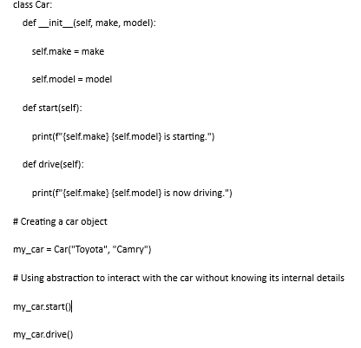
Abstraction
Abstraction is the process of simplifying complex systems by focusing on the essential features while hiding unnecessary details.
In OOP, abstraction is achieved through abstract classes and interfaces
Example:
You don't need to know how the start and drive methods of the Car class are implemented or what's happening under the hood. You only need to know that you can call these methods to start and drive the car. This is abstraction in action, simplifying your interaction with objects by hiding the underlying complexity.

Slide 12
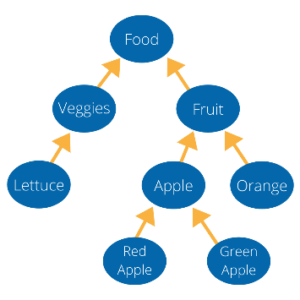
Inheritance
Inheritance allows a new class (called a subclass or derived class) to inherit properties and behaviors (attributes and methods) from an existing class (called a superclass or base class).
In OOP, you can create a new class (child class or subclass) that inherits attributes and behaviors from an existing class (parent class or superclass).
The subclass automatically has access to all the attributes and methods defined in the superclass, without the need to redefine them.

Slide 13
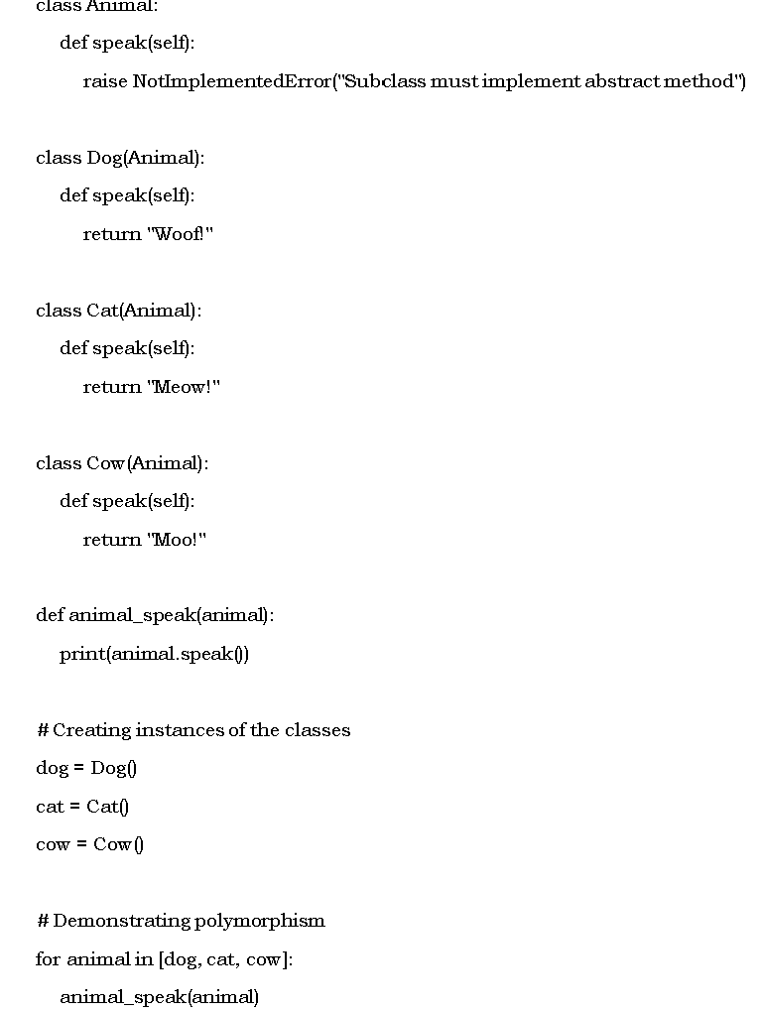
Polymorphism
Polymorphism in simple terms means "many shapes" or "many forms."
In programming, it refers to the ability of different objects to respond to the same function or method call in their own unique way.
Codes are written so that objects of a different classes behaviour as if they were objects of a single class.
These different objects can all be treated as instances of the same class, and they can use the same interface (methods or functions) to perform their actions, but each class will provide its own specific behavior for those interfaces.

Slide 14
Polymorphism
The base class Animal with a method speak that is not implemented (it raises a NotImplementedError).
We have three subclasses: Dog, Cat, and Cow, each of which overrides the speak method to return their respective sounds.
The function animal_speak takes an Animal object and prints the result of its speak method.
When we create instances of Dog, Cat, and Cow and pass them to the animal_speak function, each object invokes its own version of the speak method, demonstrating polymorphism.

Slide 15
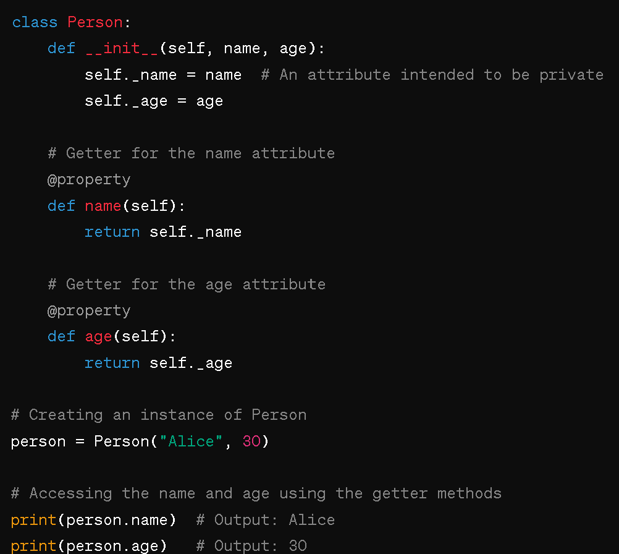
Other terms used in OOP
Getters (attribute of an object)
also known as accessor methods, are special methods in object-oriented programming (OOP) that are used to retrieve or get the values of private or protected variables (also known as attributes or properties) of an object.
In simple terms, getters provide a way to access the values of variables within an object from outside the object. They allow other parts of the program to retrieve information about the object's state without directly accessing or modifying the variables.

Slide 16
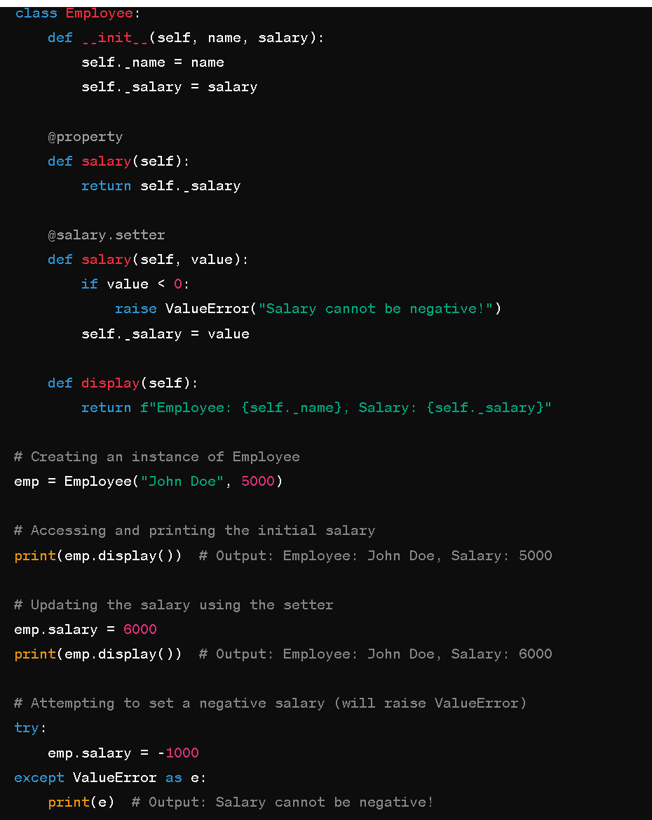
Setters
Setter are methods used to set or update the value of an attribute.
Just like getters, setters can be defined using the @property decorator along with the @<property_name>.setter decorator.
Setters are particularly useful when you want to enforce certain conditions or validations before setting an attribute's value.

Slide 17
Constructors
Setters
A constructor instantiates the object and assigns initial values to the attributes.
a constructor is like a blueprint or recipe for creating an object.
It ensures that the object is properly set up with the necessary initial values and configurations.
Setter are methods used to set or update the value of an attribute.
Just like getters, setters can be defined using the @property decorator along with the @<property_name>.setter decorator.
Setters are particularly useful when you want to enforce certain conditions or validations before setting an attribute's value.
The constructor method in Python is __init__(self, ...),
where self refers to the current instance of the class, and the rest of the parameters can be used to pass initial values to the object.

